Slide 1
Linked List

Slide 2
Content
Singly Linked List
Doubly Linked List
Circular Linked List
Applications

Slide 3
Singly Linked List
A linked list is a linear collection of data elements, called nodes, where the linear order is given by means of pointers.
Each node is divided into two parts:
The first part contains the information of the element and
The second part contains the address of the next node (link /next pointer field) in the list.

Slide 4
Contd.
Linked List can be defined as collection of objects called nodes that are randomly stored in the memory.
A node contains two fields i.e. data stored at that particular address and the pointer which contains the address of the next node in the memory.
The last node of the list contains pointer to the null.

Slide 5
Properties
The list is not required to be contiguously present in the memory. The node can reside any where in the memory and linked together to make a list. This achieves optimized utilization of space.
list size is limited to the memory size and doesn't need to be declared in advance.
Empty node can not be present in the linked list.
We can store values of primitive types or objects in the singly linked list.

Slide 6
Disadvantage of Arrays
The size of array must be known in advance before using it in the program.
Increasing size of the array is a time taking process. It is almost impossible to expand the size of the array at run time.
All the elements in the array need to be contiguously stored in the memory. Inserting any element in the array needs shifting of all its predecessors.

Slide 7
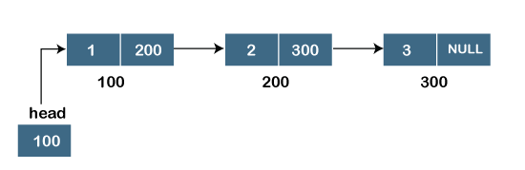
Representation
data
next
struct node
{
int data;
struct node *next;
}
struct node * head;

Slide 8
Operations
Insertion
at beginning
at end
after specified node
Deletion
at beginning
at end
after specified node
Traversing
Searching

Slide 9
Basic Code
#include<stdio.h>
#include<stdlib.h>
struct node
{
int data;
struct node *next;
};
struct node *head;

Slide 10
Insert at the beginning

Slide 11
Contd.

Slide 12
Contd.

Slide 13
Contd.

Slide 14
Contd.

Slide 15
Code
void beginsert()
{
struct node *ptr;
int item;
ptr = (struct node *) malloc(sizeof(struct node *));
if(ptr == NULL)
{
printf("\nOVERFLOW");
}
else
{
printf("\nEnter value\n");
scanf("%d",&item);
ptr->data = item;
ptr->next = head;
head = ptr;
printf("\nNode inserted");
}
}

Slide 16
Insert at the end

Slide 17
Contd.

Slide 18
Contd.

Slide 19
Contd.

Slide 20
Contd.

Slide 21
Code
void lastinsert()
{
struct node *ptr,*temp;
int item;
ptr = (struct node*)malloc(sizeof(struct node));
if(ptr == NULL)
{
printf("\nOVERFLOW");
}

Slide 22
Code
else
{
temp = head;
while (temp -> next != NULL)
{
temp = temp -> next;
}
temp->next = ptr;
ptr->next = NULL;
printf("\nNode inserted");
}
}
}
else
{
printf("\nEnter value?\n");
scanf("%d",&item);
ptr->data = item;
if(head == NULL)
{
ptr -> next = NULL;
head = ptr;
printf("\nNode inserted");
}

Slide 23
Insert after location

Slide 24
Code
ptr->data = item;
printf("\nEnter the location after which you want to insert ");
scanf("\n%d",&loc);
temp=head;
for(i=0;i<loc;i++)
{
temp = temp->next;
if(temp == NULL)
{
printf("\ncan't insert\n");
return;
}
void randominsert()
{
int i,loc,item;
struct node *ptr, *temp;
ptr = (struct node *) malloc (sizeof(struct node));
if(ptr == NULL)
{
printf("\nOVERFLOW");
}
else
{
printf("\nEnter element value");
scanf("%d",&item);

Slide 25
Contd.
}
ptr ->next = temp ->next;
temp ->next = ptr;
printf("\nNode inserted");
}
}

Slide 26
Deletion from beginning

Slide 27
Contd.

Slide 28
Contd.

Slide 29
Contd.

Slide 30
Contd.

Slide 31
Contd.

Slide 32
Code
void begin_delete()
{
struct node *ptr;
if(head == NULL)
{
printf("\nList is empty\n");
}
else
{
ptr = head;
head = ptr->next;
free(ptr);
printf("\nNode deleted from the begining ...\n");
}
}

Slide 33
Deletion from End

Slide 34
Contd.

Slide 35
Contd.

Slide 36
Contd.

Slide 37
Contd.

Slide 38
Code
void last_delete()
{
struct node *ptr,*ptr1;
if(head == NULL)
{
printf("\nlist is empty");
}
else if(head -> next == NULL)
{
head = NULL;
free(head);
printf("\nOnly node of the list deleted ...\n");
}
else
{
ptr = head;
while(ptr->next != NULL)
{
ptr1 = ptr;
ptr = ptr ->next;
}
ptr1->next = NULL;
free(ptr);
printf("\nDeleted Node from the last ...\n");
}
}

Slide 39
Delete after location

Slide 40
Code
void random_delete()
{
struct node *ptr,*ptr1;
int loc,i;
printf("\n Enter the location of the node after which you want to perform deletion \n");
scanf("%d",&loc);
ptr=head;
for(i=0;i<loc;i++)
{
ptr1 = ptr;
ptr = ptr->next;
if(ptr == NULL)
{
printf("\nCan't delete");
return;
}
}
ptr1 ->next = ptr ->next;
free(ptr);
printf("\nDeleted node %d ",loc+1);
}

Slide 41
Searching
if(ptr->data == item)
{
printf("item found at location %d ",i+1);
flag=0;
}
else
{
flag=1;
}
i++;
ptr = ptr -> next;
}
if(flag==1)
{
printf("Item not found\n");
}
} }
void search()
{
struct node *ptr;
int item,i=0,flag;
ptr = head;
if(ptr == NULL)
{
printf("\nEmpty List\n");
}
else
{
printf("\nEnter item which you want to search?\n");
scanf("%d",&item);
while (ptr!=NULL)
{

Slide 42
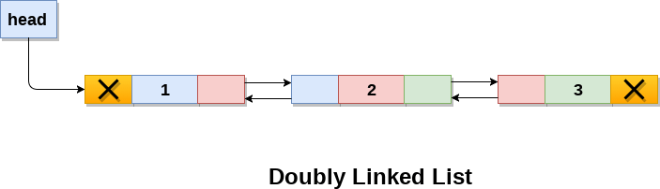
Doubly Linked List: Representation
struct node
{
struct node *prev;
int data;
struct node *next;
}

Slide 43
Operations
Insertion
at beginning
at end
after specified node
Deletion
at beginning
at end
after specified node
Traversing
Searching

Slide 44
Codes

Slide 45
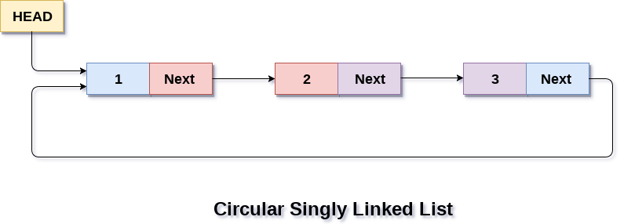
Circular Linked List: Representation
struct node
{
int data;
struct node *next;
}
struct node * head;

Slide 46
Operations
Insertion
at beginning
at end
Deletion
at beginning
at end
Traversing
Searching

Slide 47
Codes

Slide 48
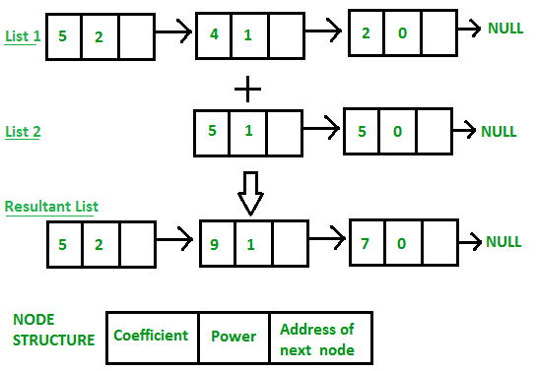
Adding two polynomials

Slide 49
Code
// Node structure containing power and coefficient of
// variable
struct Node {
int coeff;
int pow;
struct Node* next;
};

Slide 50
Node Creation
// Function to create new node
void create_node(int x, int y, struct Node** temp)
{
struct Node *r, *z;
z = *temp;
if (z == NULL) {
r = (struct Node*)malloc(sizeof(struct Node));
r->coeff = x;
r->pow = y;
*temp = r;
r->next = (struct Node*)malloc(sizeof(struct Node));
r = r->next;
r->next = NULL;
}
else {
r->coeff = x;
r->pow = y;
r->next = (struct Node*)malloc(sizeof(struct Node));
r = r->next;
r->next = NULL;
}
}

Slide 51
Polynomial Add
// Function Adding two polynomial numbers
void polyadd(struct Node* poly1, struct Node* poly2,
struct Node* poly)
{
while (poly1->next && poly2->next) {
// If power of 1st polynomial is greater then 2nd,
// then store 1st as it is and move its pointer
if (poly1->pow > poly2->pow) {
poly->pow = poly1->pow;
poly->coeff = poly1->coeff;
poly1 = poly1->next;
}

Slide 52
Contd.
// If power of 2nd polynomial is greater then 1st,
// then store 2nd as it is and move its pointer
else if (poly1->pow < poly2->pow) {
poly->pow = poly2->pow;
poly->coeff = poly2->coeff;
poly2 = poly2->next;
}
// If power of both polynomial numbers is same then
// add their coefficients
else {
poly->pow = poly1->pow;
poly->coeff = poly1->coeff + poly2->coeff;
poly1 = poly1->next;
poly2 = poly2->next;
}

Slide 53
Contd.
// Dynamically create new node
poly->next
= (struct Node*)malloc(sizeof(struct Node));
poly = poly->next;
poly->next = NULL;
}

Slide 54
Contd.
while (poly1->next || poly2->next) {
if (poly1->next) {
poly->pow = poly1->pow;
poly->coeff = poly1->coeff;
poly1 = poly1->next;
}
if (poly2->next) {
poly->pow = poly2->pow;
poly->coeff = poly2->coeff;
poly2 = poly2->next;
}
poly->next
= (struct Node*)malloc(sizeof(struct Node));
poly = poly->next;
poly->next = NULL;
}
}

Slide 55
Contd.
// Display Linked list
void show(struct Node* node)
{
while (node->next != NULL) {
printf("%dx^%d", node->coeff, node->pow);
node = node->next;
if (node->coeff >= 0) {
if (node->next != NULL)
printf("+");
}
}
}

Slide 56
Driver Code
// Driver code
int main()
{
struct Node *poly1 = NULL, *poly2 = NULL, *poly = NULL;
// Create first list of 5x^2 + 4x^1 + 2x^0
create_node(5, 2, &poly1);
create_node(4, 1, &poly1);
create_node(2, 0, &poly1);
// Create second list of -5x^1 - 5x^0
create_node(-5, 1, &poly2);
create_node(-5, 0, &poly2);
printf("1st Number: ");
show(poly1);
printf("\n2nd Number: ");
show(poly2);
poly = (struct Node*)malloc(sizeof(struct Node));
// Function add two polynomial numbers
polyadd(poly1, poly2, poly);
// Display resultant List
printf("\nAdded polynomial: ");
show(poly);
return 0;
}

Slide 57
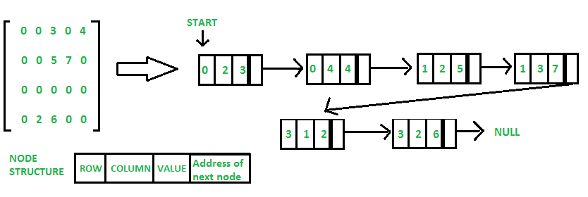
Sparse Matrix Representation

Slide 58
Code
// C program for Sparse Matrix Representation
// using Linked Lists
#include<stdio.h>
#include<stdlib.h>
// Node to represent sparse matrix
struct Node
{
int value;
int row_position;
int column_postion;
struct Node *next;
};

Slide 59
Contd.
// Function to create new node
void create_new_node(struct Node** start, int non_zero_element,
int row_index, int column_index )
{
struct Node *temp, *r;
temp = *start;
if (temp == NULL)
{
// Create new node dynamically
temp = (struct Node *) malloc (sizeof(struct Node));
temp->value = non_zero_element;
temp->row_position = row_index;
temp->column_postion = column_index;
temp->next = NULL;
*start = temp;
}
else
{
while (temp->next != NULL)
temp = temp->next;
// Create new node dynamically
r = (struct Node *) malloc (sizeof(struct Node));
r->value = non_zero_element;
r->row_position = row_index;
r->column_postion = column_index;
r->next = NULL;
temp->next = r;
}
}

Slide 60
Contd.
// This function prints contents of linked list
// starting from start
void PrintList(struct Node* start)
{
struct Node *temp, *r, *s;
temp = r = s = start;
printf("row_position: ");
while(temp != NULL)
{
printf("%d ", temp->row_position);
temp = temp->next;
}
printf("\n");
printf("column_postion: ");
while(r != NULL)
{
printf("%d ", r->column_postion);
r = r->next;
}
printf("\n");
printf("Value: ");
while(s != NULL)
{
printf("%d ", s->value);
s = s->next;
}
printf("\n");
}

Slide 61
Contd.
// Driver of the program
int main()
{
// Assume 4x5 sparse matrix
int sparseMatric[4][5] =
{
{0 , 0 , 3 , 0 , 4 },
{0 , 0 , 5 , 7 , 0 },
{0 , 0 , 0 , 0 , 0 },
{0 , 2 , 6 , 0 , 0 }
};
/* Start with the empty list */
struct Node* start = NULL;
for (int i = 0; i < 4; i++)
for (int j = 0; j < 5; j++)
// Pass only those values which are non - zero
if (sparseMatric[i][j] != 0)
create_new_node(&start, sparseMatric[i][j], i, j);
PrintList(start);
return 0;
}

